Slide 1
S-100 Validation Tests sub group
8th VTC Meeting
22nd April 2024

Slide 2
Meeting protocol
Meeting participants are kindly requested to note the following meeting protocols;
Please keep your camera and microphone turned “off” if you are not talking or presenting
If you want to make an intervention, please turn your camera and microphone on and, raise your hand to indicate that you wish to speak
Don’t forget to turn your microphone “on” before speaking, and “off” when finished
Please use the “Chat” function to communicate an text information to the meeting
If you have any problems connecting using Firefox or other browser – please try using Chrome.

Slide 3
AGENDA
S-100 TSM 10
Summary of meeting relevant to S-100 Validation
Status on tasks
Issues raised
Status on tasks
Next meeting

Slide 4
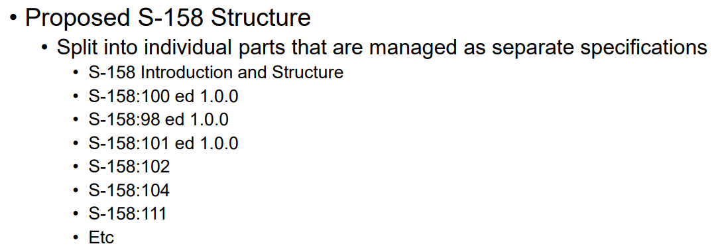
S-100 TSM 10 – 12-15TH march, Monaco
Summary of sub-group report
https://github.com/iho-ohi/S-100-Validation-Checks/blob/main/Meetings/S100%20Validation_TSM10_March2024.pptx
(S100 Val GitHub or IHO TSM10 page)
Current Situation
Use S-158 & agreed structure – inform HSSC 16
Template and Standardised Naming Convention outstanding (deadline 2024)
Update to S-97 outstanding (deadline 2024)
No further progress in writing new checks since S-100 WG8, looking into funding options
Cross product validation checks, looking into funding options
Will be submitted to HSSC 17 2025
Initial tests Part1, Part 2, Part 4b, Part 5, Part 6, Part 7(not finished), Part 10a (not finished), Part 10c, Part 17
Part 1 checks from S-101 PT (Validation) have been uploaded, primarily 10a – frontpage or spreadsheet
https://github.com/iho-ohi/S-100-Validation-Checks/blob/main/Documents/S100ValidationTests_4.xlsx

Slide 5
S-100 TSM 10 – 12-15TH march, Monaco
Versioning
There were lots of versioning discussions particularly with catalogues and datasets, agreement to support principle that the first two numbers will be synchronous. S-100 Validation will follow agreed principles.
How Capture Checks
Discussed using more advanced GitHub – similar to S-102 (Metanorma)
IHO Sec along with the S-100 ICE PT to evaluate the document of a guidance document and training focused on managing document, particularly for S-100, utilizing GitHub for document management.
IHO Sec to invite S-100 VSG Chair to participate in the training session regarding Document management in the GitHub, organized for the IHO Marine Spatial Data Infrastructure Working Group (MSDIWG).
Change process
Once live, will need to look into a Managed Impact Study timeline

Slide 6
ISSues
https://github.com/iho-ohi/S-100-Validation-Checks/issues

Slide 7
Next steps
Continue producing a set of tests from Parts of S-100
Tabulate and place on GitHub
Then group to comment and raise issues using Check ID in title
368 tests written from Part1, Part 2, Part 4b, Part 5, Part 6, Part 7 (not finished), Part 10a, Part 10c, Part 17
Trying to arrange assistance with Julia
Finalise and circulate naming convention and validation test structure
Coordinate Cross-Product Validation with S-98/S-164 lead, DQWG and S-1xx PS owners
Document write up with an initial explanation of ‘what is S-100 level validation’

Slide 8
Next meetings
HSSC16 27th-31st May, Tokyo
Suggest next meeting is Tuesday 25th June or Monday 1st July.
Any volunteers to write or review checks please contact me and Yong.

Slide 9
Any Questions?

